Slide 1
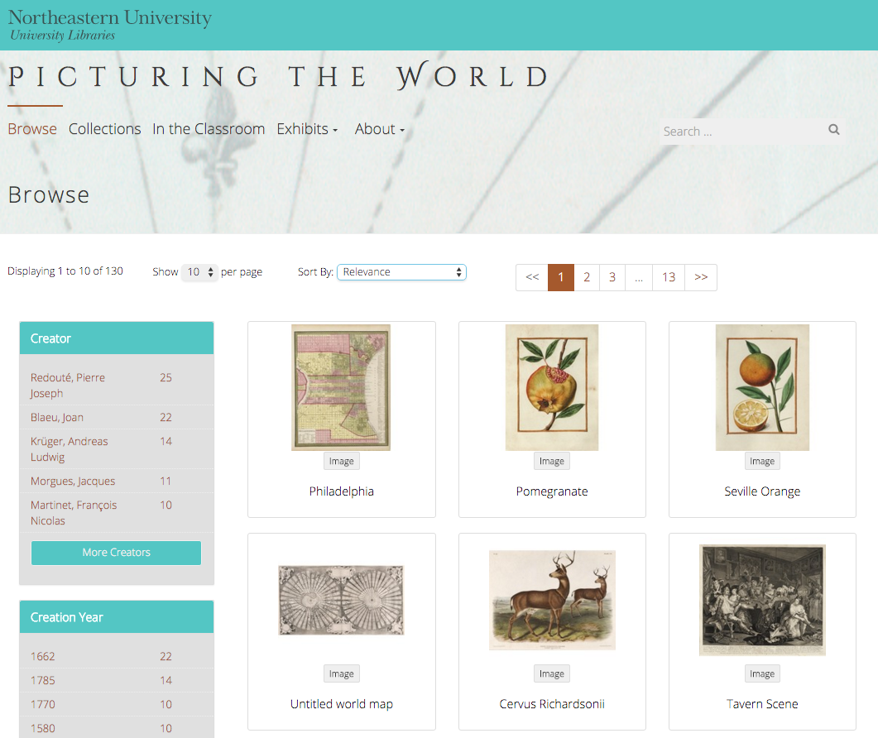
The DRS Project Toolkit
Sarah Sweeney
Digital Repository Manager
Northeastern University Libraries

Slide 2
CERES: Exhibit Toolkit
Sarah Sweeney
Digital Repository Manager
Northeastern University Libraries

Slide 3
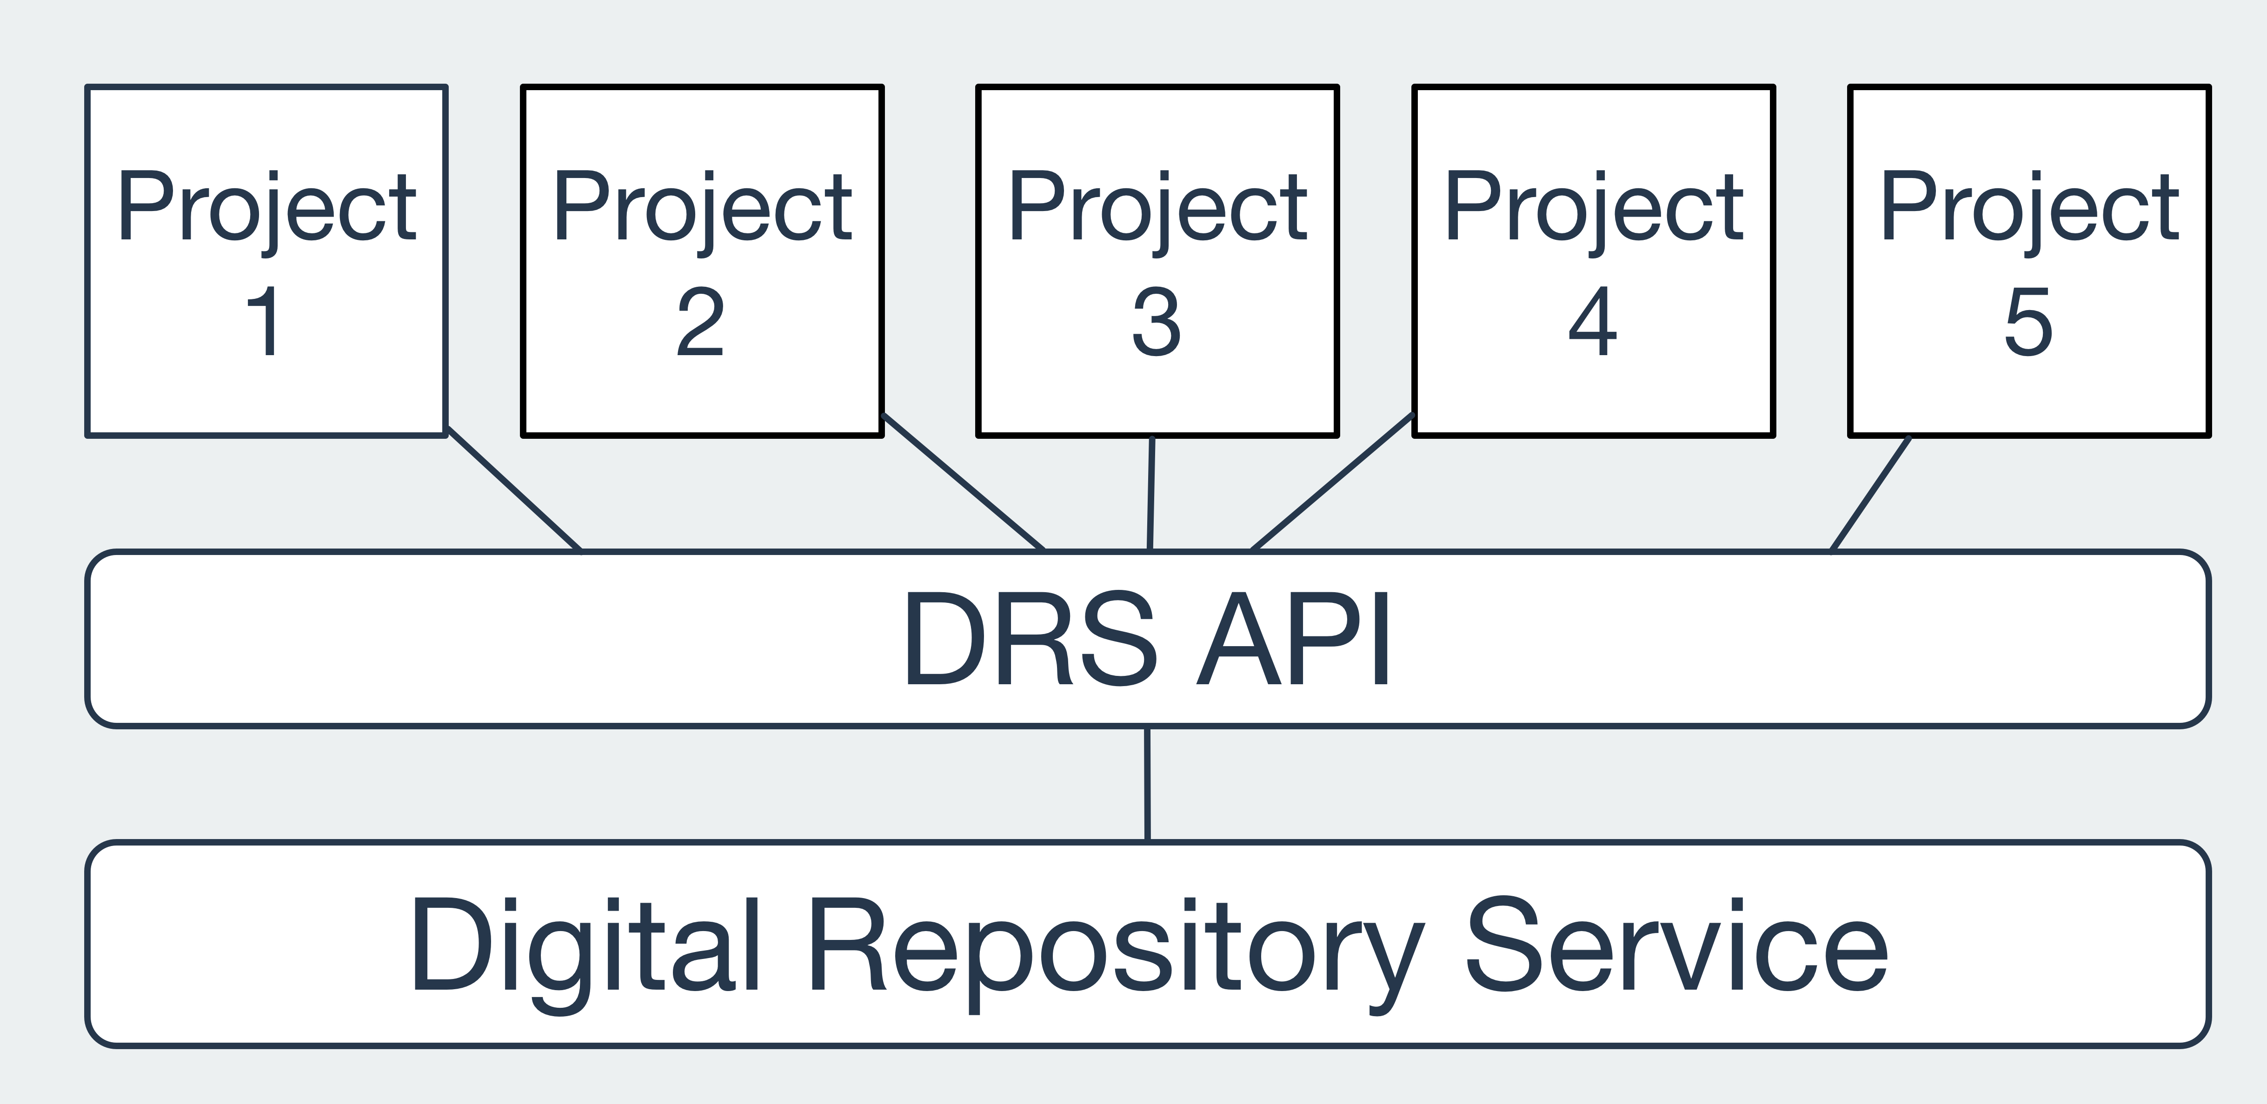
Architecture

Slide 4
Features
Faceted searching
Collection and file browsing
File downloading
Galleries
Playlists
Maps
Timelines

Slide 5
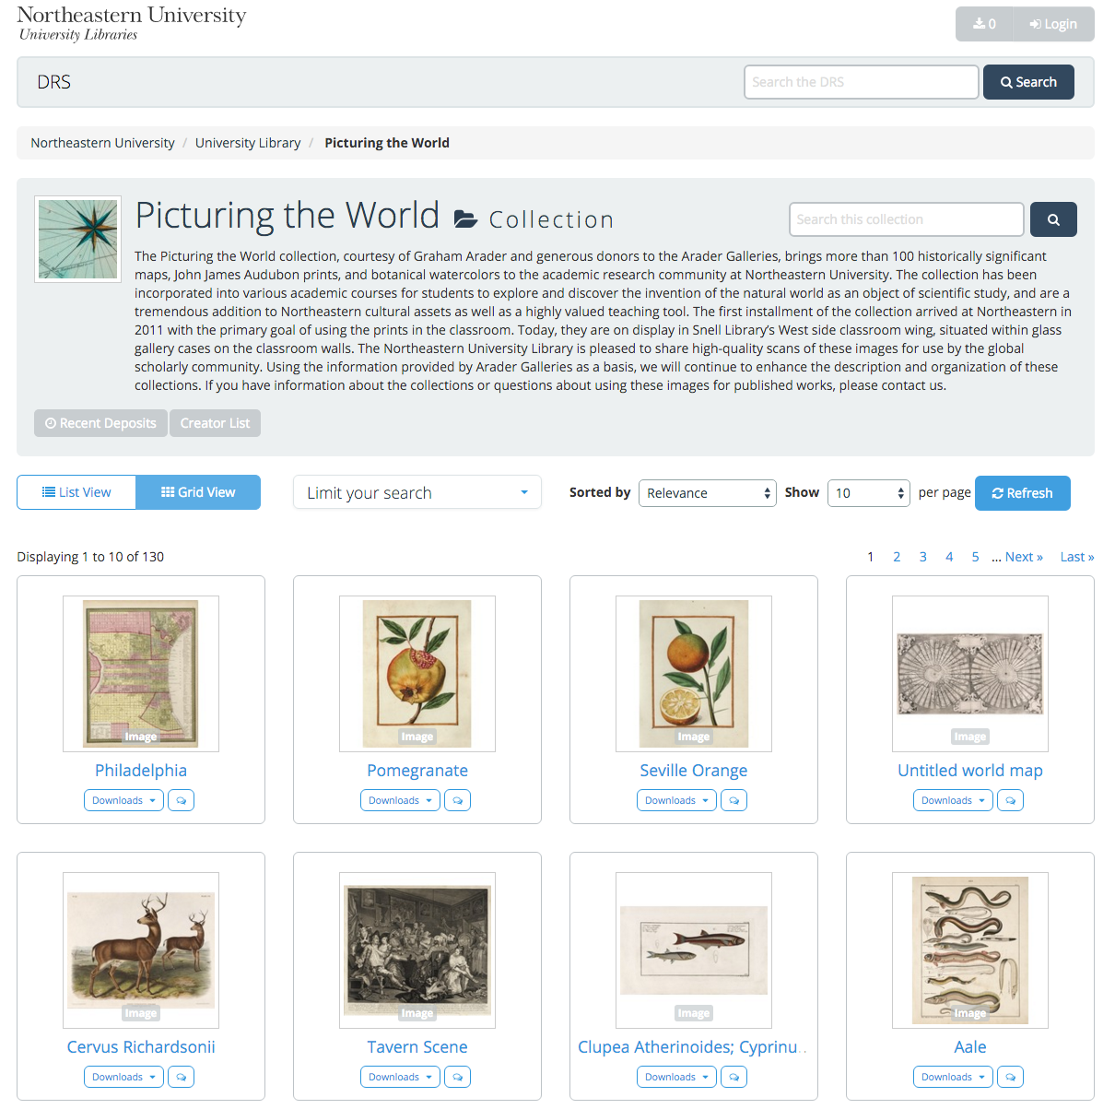
Digital Repository Service
Picturing The World
https://repository.library.northeastern.edu
http://arader.library.northeastern.edu

Slide 6
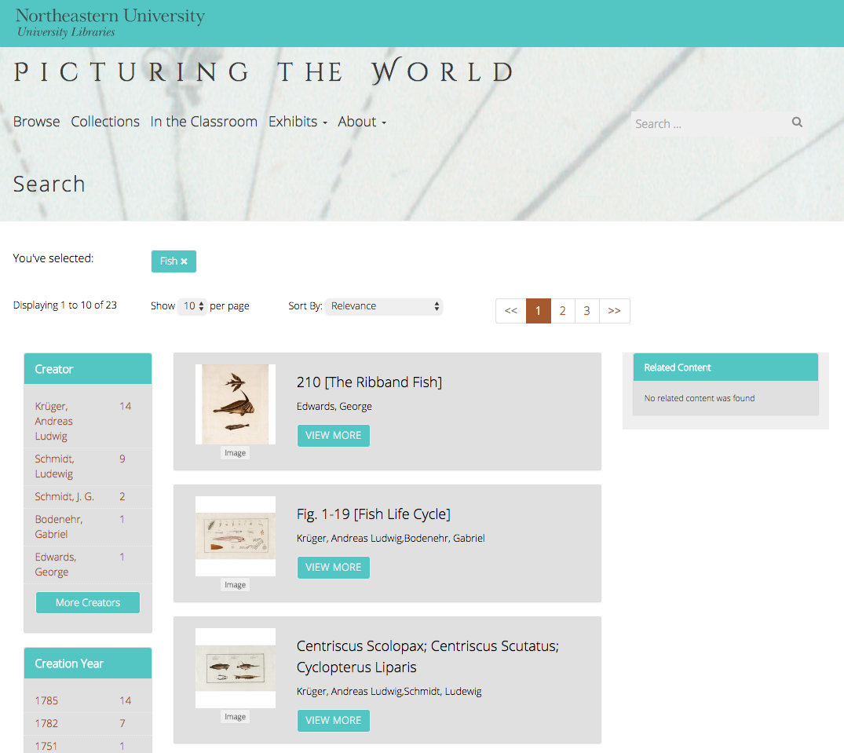
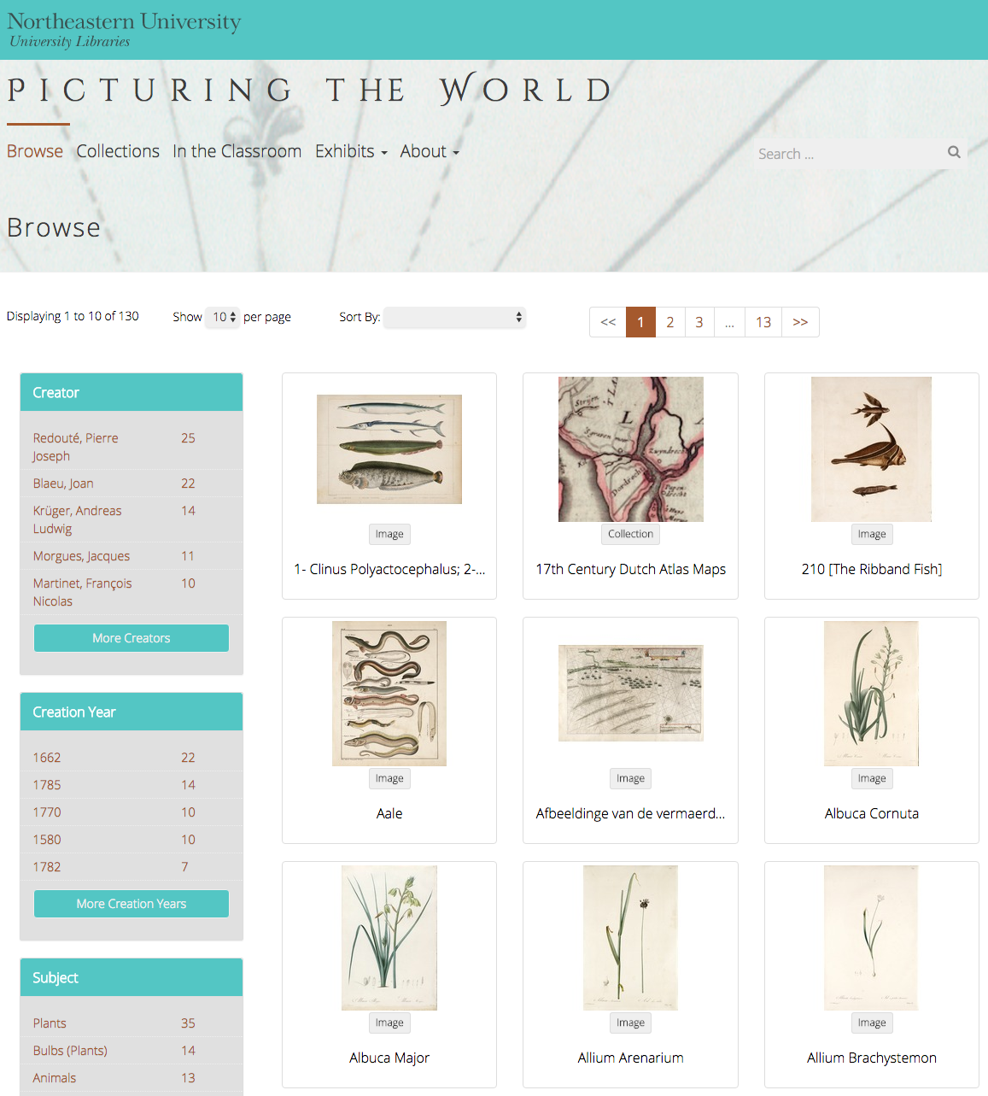
Discovery
Search
Browse

Slide 7
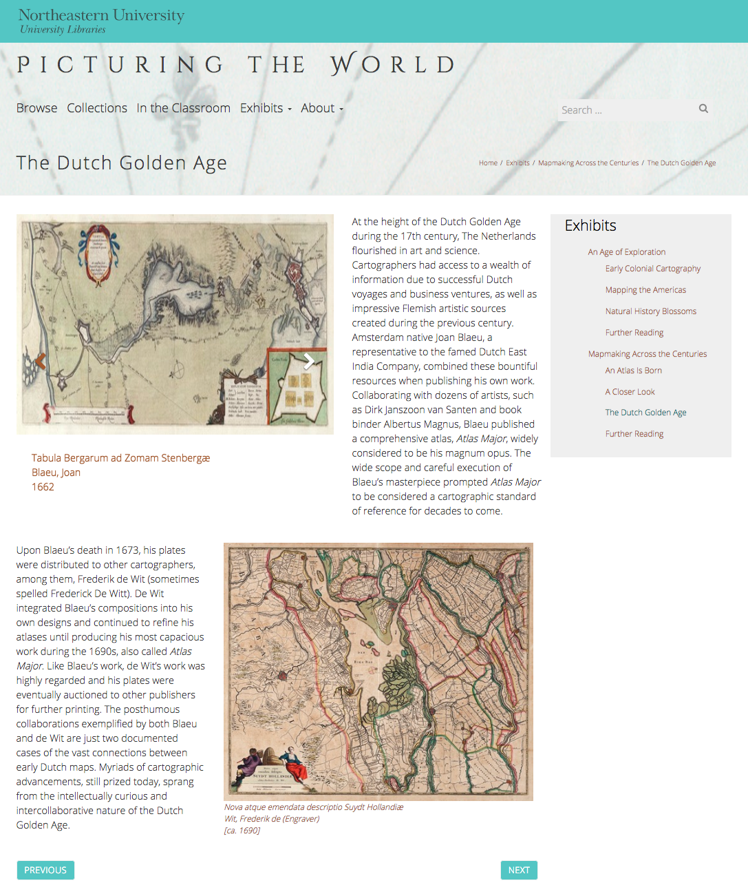
Custom Gallery

Slide 8
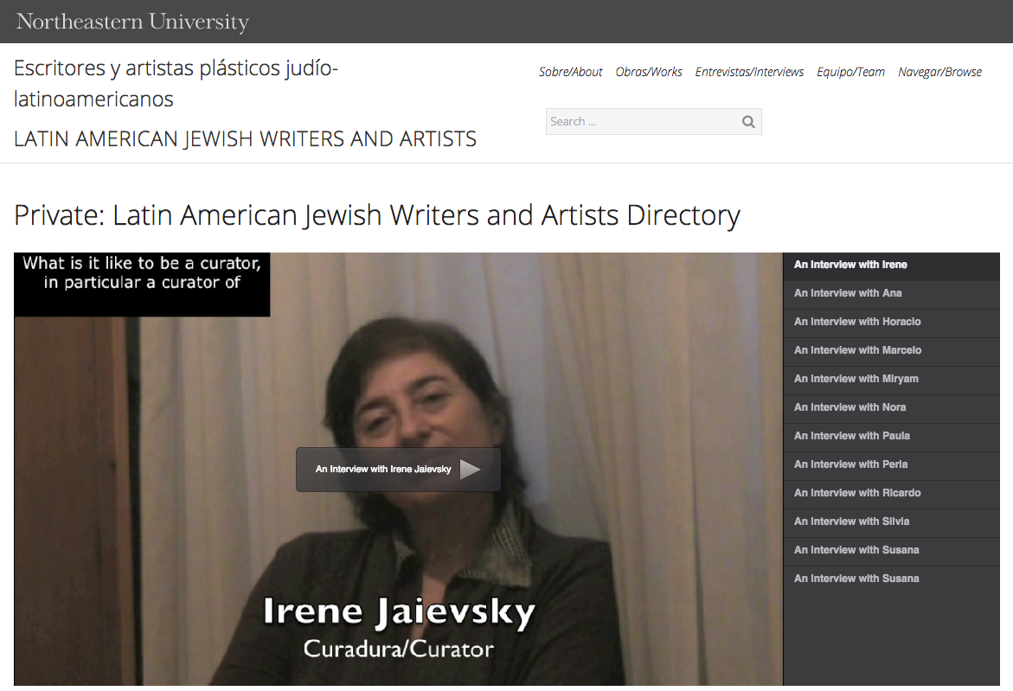
Playlist

Slide 9
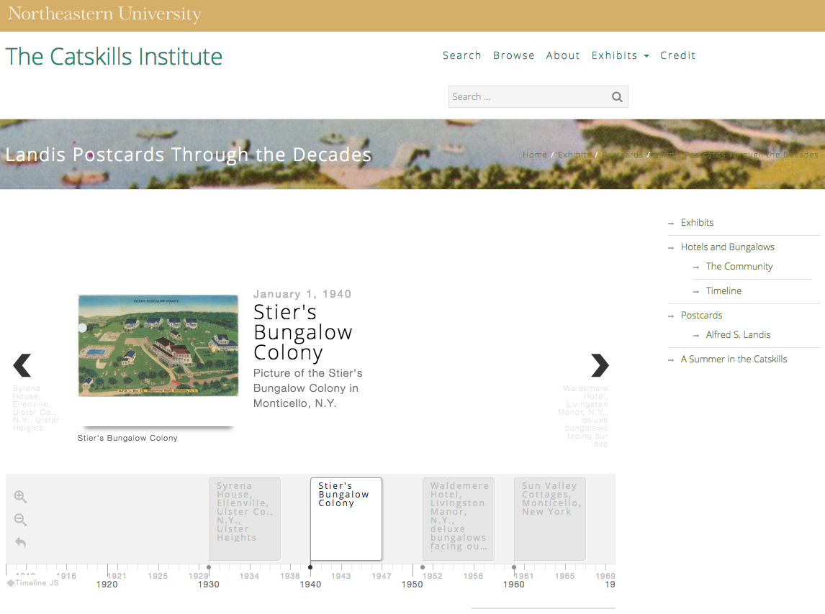
Timeline

Slide 10
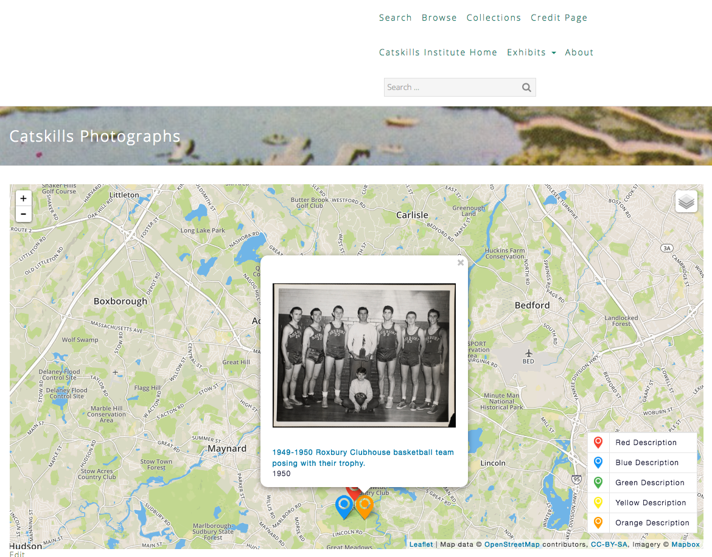
Map

Slide 11
Sites
Live Sites
http://dsg.neu.edu/projects
Interviews with Jewish Latin American Writers and Artists
Picturing the World Gallery
A Proud Past: A History of Boston-Bouvé College, 1913-1981
In Development
The Catskills Institute
Holocaust Awareness Week Programming
Spectrum Literary Magazine
DMC Studios Student Work Showcase
United South End Settlements
New Projects Projected for 2016
Dominican Prayer Book
The Civil Rights and Restorative Justice Project
The Early Black Boston Digital Almanac
The Early Caribbean Digital Archive
African American Institute Archives
Thoreau’s Journal Drawings

Slide 12

DSG
Resources
Contact
http://dsg.northeastern.edu
http://dsg.neu.edu/drs-project-toolkit
sj.sweeney@neu.edu
Sarah Sweeney
Digital Repository Manager
Northeastern University Library
repository.library.northeastern.edu

